Slide 1

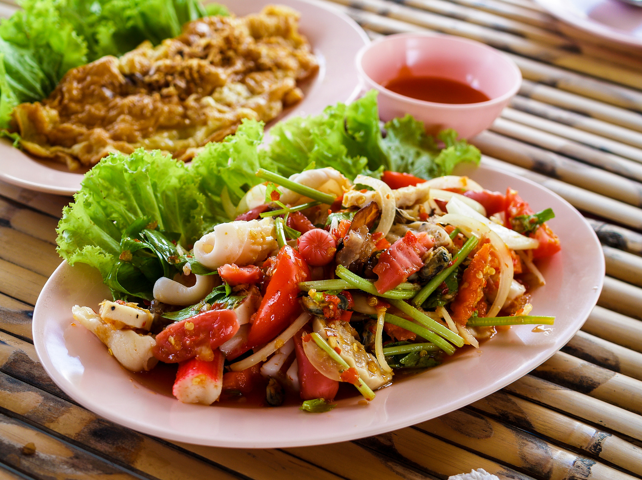

FOODHUT
1
Architecting a Comprehensive Culinary Exploration Platform: Crafting a Multi-Cuisine App for Seamless Dining Experiences

Slide 2


Table of contents
01
About the Project
04
Backend Development
02
Architecture Overview
05
Database Integration
03
Frontend Development
06
Security Measures
2
You can describe the topic of the section here
You can describe the topic of the section here
You can describe the topic of the section here
You can describe the topic of the section here
You can describe the topic of the section here
You can describe the topic of the section here
Foodhut

Slide 3

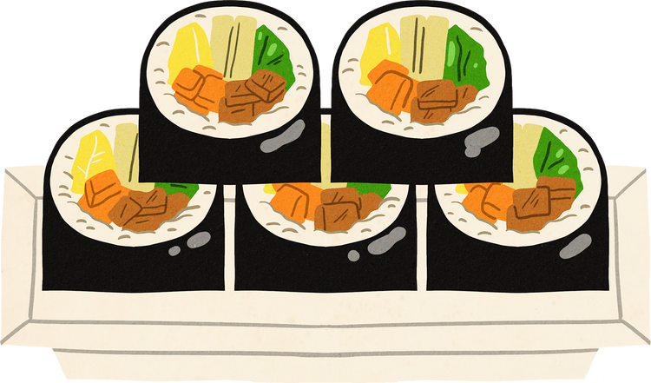
Table of contents
07
DEMO
09
Conclusion
08
Future Enhancements
10
Q & A
3
You can describe the topic of the section here
You can describe the topic of the section here
You can describe the topic of the section here
You can describe the topic of the section here
Foodhut

Slide 4


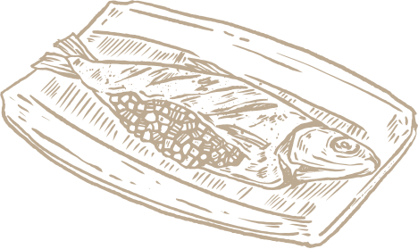
Our team
Nitin Rathore
Saicharan
Rupfuto Kezo
4
Foodhut

Slide 5

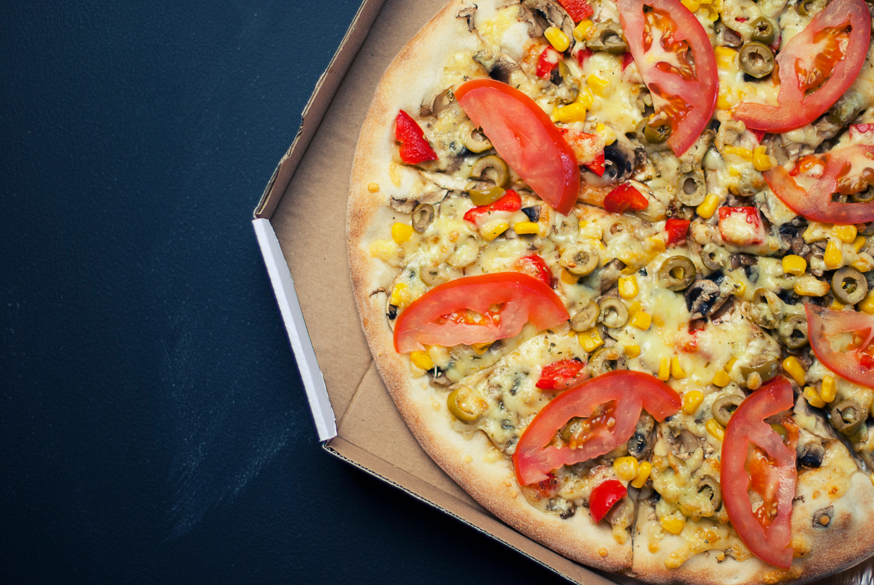





FoodHut
5
the one-stop-shop for timely food deliveries.
Foodhut

Slide 6


OBJECTIVE
6
“Build a system where users can find different cuisines in a single App like Zomato App."
Foodhut

Slide 7


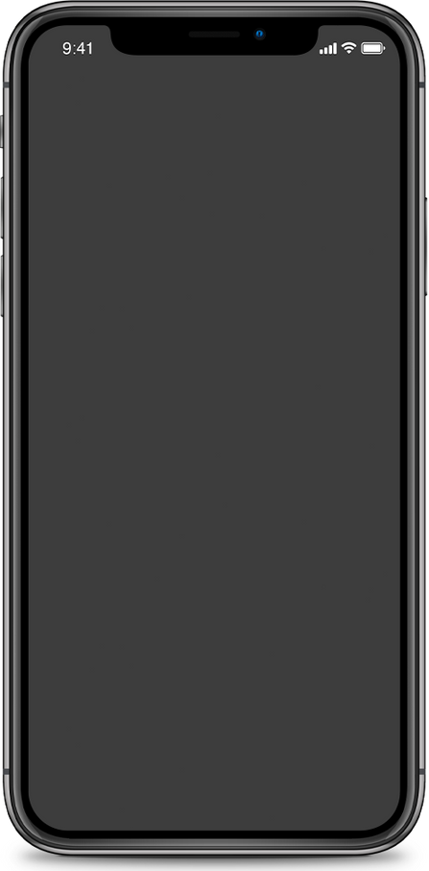
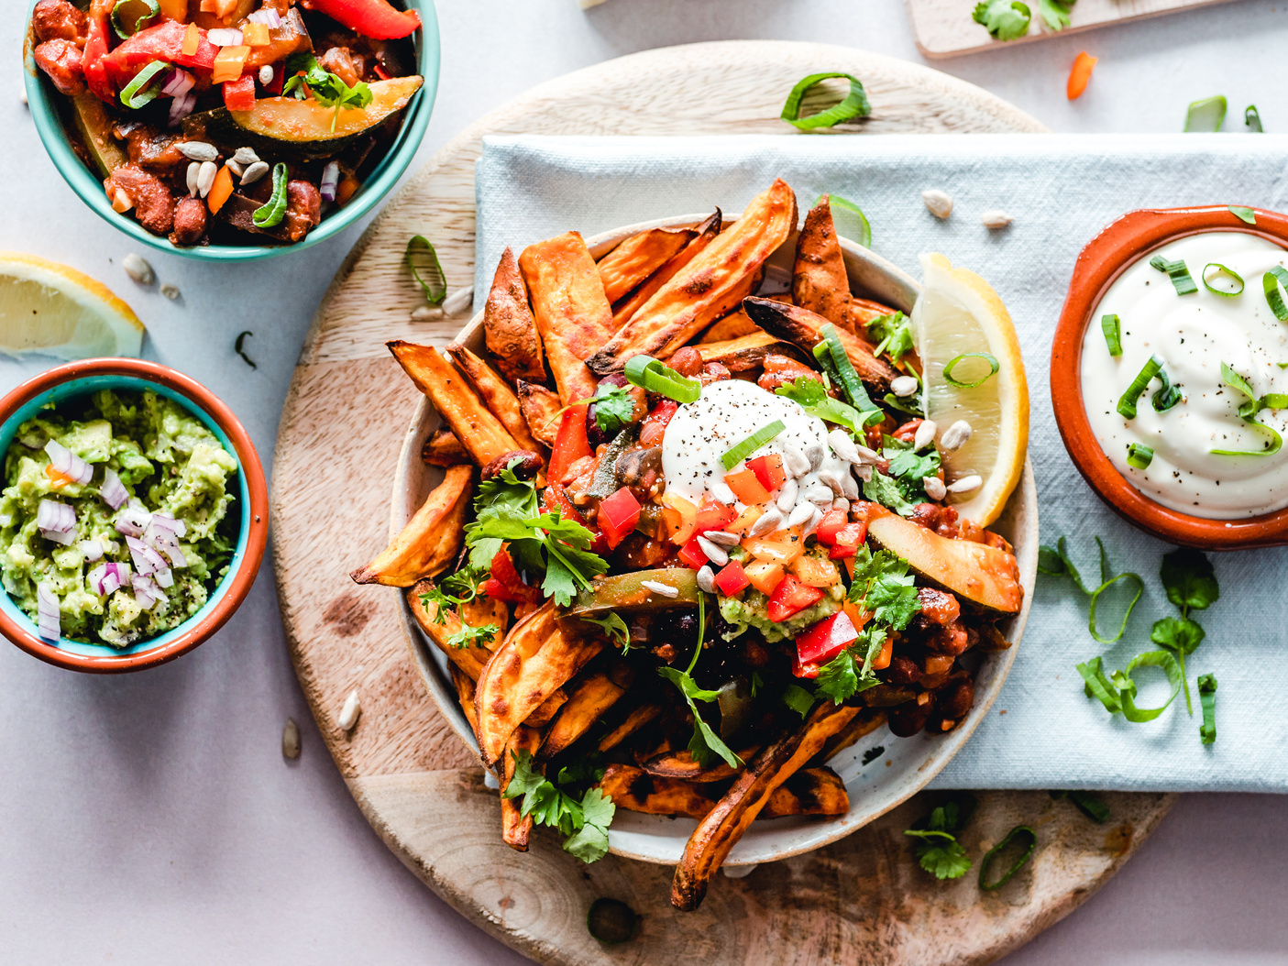

01.
Introduction
7
Foodhut

Slide 8

Brief Overview of the Project:
8
Our project aims to develop a robust and user-friendly application that consolidates diverse cuisines into a single platform, reminiscent of the Zomato app
Foodhut

Slide 9

Introduction
Purpose and Goals:
Target Audience:
9
To provide a one-stop solution for users to explore and discover different cuisines within a unified application.
Our target audience encompasses individuals with a passion for exploring diverse culinary experiences.
Foodhut

Slide 10



02.
Architecture Overview
10
Foodhut

Slide 11




FullStack Architecture
Angular
Springboot
MongoDB & MySQL
11
Front End
Back End
Database
Angular, powered by TypeScript, ensures a seamless user experience while efficiently connecting with the backend.
A Java-based framework, seamlessly handles backend operations, ensuring smooth communication with the frontend through RESTful API.
MongoDB manages dynamic culinary data with flexibility, while MySQL ensures data integrity for structured information like user profiles in our application.
Foodhut

Slide 12




Architecture
12
Controller
Layer
Service
Layer
Repository
Layer
Component
Router
Service
Foodhut

Slide 13

03.
Frontend Development
13
Foodhut

Slide 14
Technologies Used
TypeScript
Angular
14
TypeScript, a superset of JavaScript, brings static typing to enhance code quality and developer productivity in our frontend development.
Angular, a powerful and modular frontend framework, structures our user interface, enabling dynamic and responsive interactions crucial for a seamless culinary exploration experience.
Foodhut

Slide 15
Project Structure
15
The front-end project structure adheres to a modular and organized design, typical for a TypeScript/Angular application. Key components include:
/app:
/components: Houses individual components responsible for specific UI elements.
/services: Contains services handling business logic and data interactions.
/models: Stores data models defining the structure of application data.
Foodhut

Slide 16
Features List
16
Cart
Add and remove items from your cart
Local Restaurants
Find Restaurants in and around your location
Favorites
Add restaurants and items to your favorites list
Foodhut

Slide 17


04.
Backend Development
17
Foodhut

Slide 18

Technologies Used
JAVA
Springboot
18
Primary programming language for robust backend development.
Framework providing comprehensive infrastructure support for Java-based enterprise applications.
Foodhut

Slide 19

Backend Architecture
19
Restaurant app
Customer app
Auth app
Images app
manages restaurant data, handling tasks such as retrieval, storage, and updating of restaurant information.
responsible for user-related functionalities, including user profiles, preferences, and interactions with the platform.
focuses on user authentication and authorization, ensuring secure access to the application through proper authentication mechanisms.
deals with the storage and retrieval of images associated with restaurants, enriching the user experience with visual content.
Foodhut

Slide 20


05.
Database Integration
20
Foodhut

Slide 21
Database Choice and Rationale:
21
MongoDB
We've strategically chosen MongoDB for the Restaurant App, Customer App, and Image App due to its flexibility with unstructured data, ideal for handling various content types.
MySql
The Auth App utilizes MySQL, providing a robust and mature relational database solution, aligning with authentication requirements.
Foodhut

Slide 22
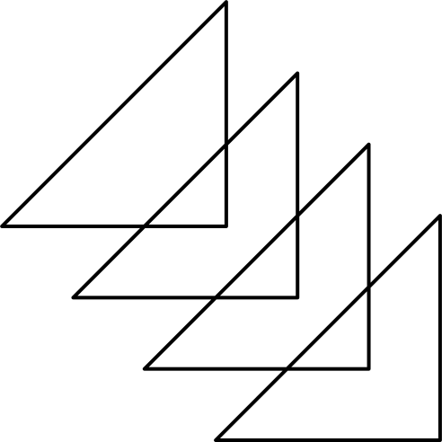
Databases
22
Customer
Auth
CustomerDB
AuthDB
Storing user profiles, preferences, and relevant customer-related data
handling user authentication and authorization.
Image
Restaurant
ImageDB
RestaurantDB
Manages restaurant-related data, including menus and other details,
Efficiently stores and retrieves images associated with the application
Foodhut

Slide 23

Restaurant DB
23
Collections
Restaurant
serves as the core repository for restaurant-related data. This includes details about different restaurants,
Item
designed to manage information about menu items.
Order
handles the storage and retrieval of order-related information
Foodhut

Slide 24

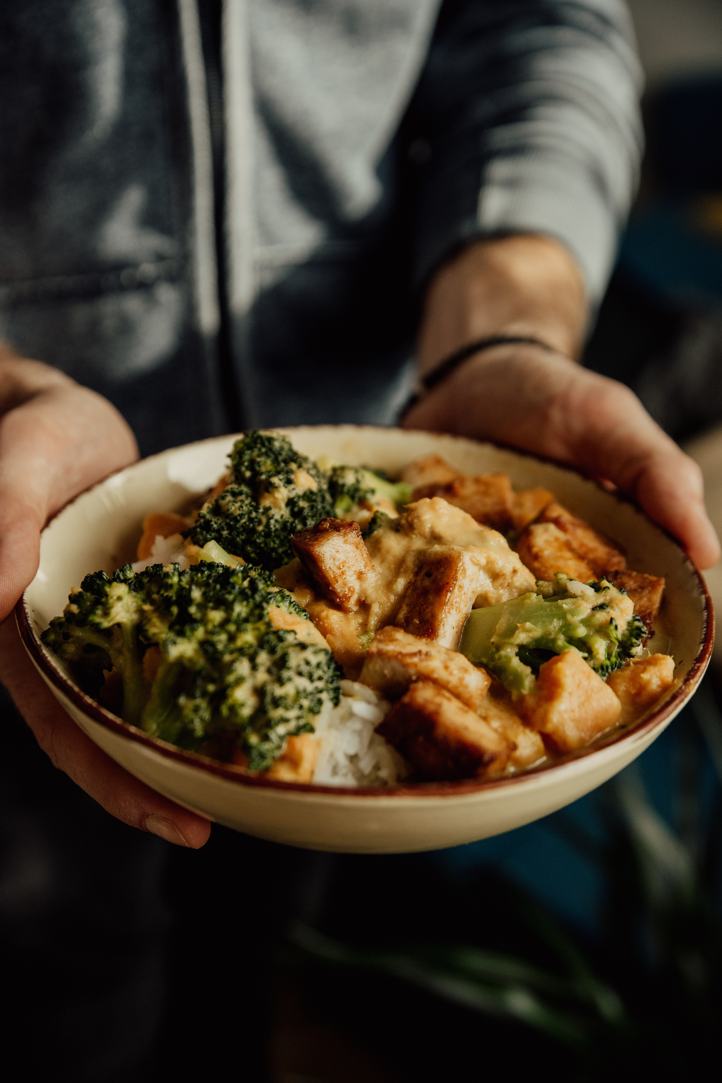

Security Measures
06.
24
Foodhut

Slide 25

Authentication and Authorization
25
JsonWebToken
Route Guarding
Verify the integrity of the transmitted data.
Controls access to different sections of the application based on user authentication and authorization status.
Form Validation
OTP
Enforce data correctness and completeness on the client side.
OTP delivered securely to the user's email, adds an extra layer of authentication
Foodhut

Slide 26
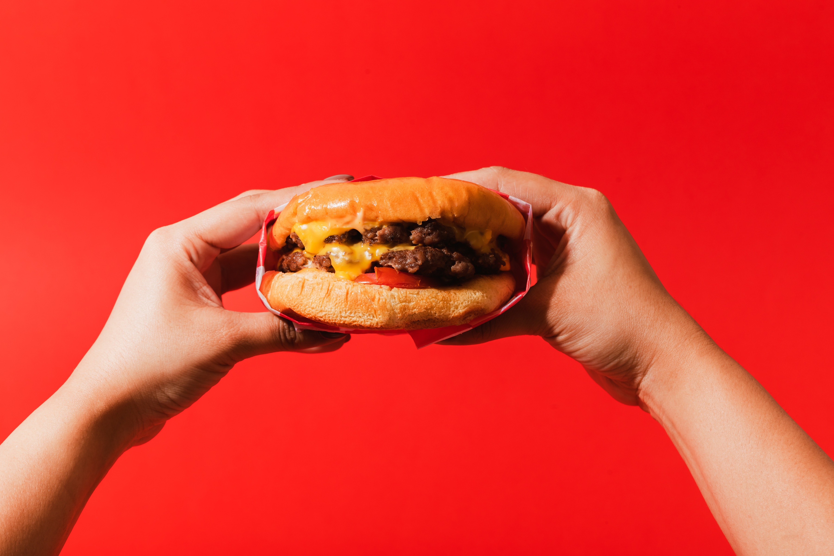
DEMO
26
07.
Foodhut

Slide 27

27
Future Enhancements
08.
Implement advanced user interface enhancements to provide a more intuitive and engaging experience.
Optimize backend services and database architecture for improved scalability to handle increased user loads seamlessly.
Consider microservices architecture to modularize components and enhance scalability.
Integrate real-time updates and notifications to enhance user interaction and keep users informed about changes in the system.
Foodhut

Slide 28

09.
Conclusions
28
Foodhut

Slide 29
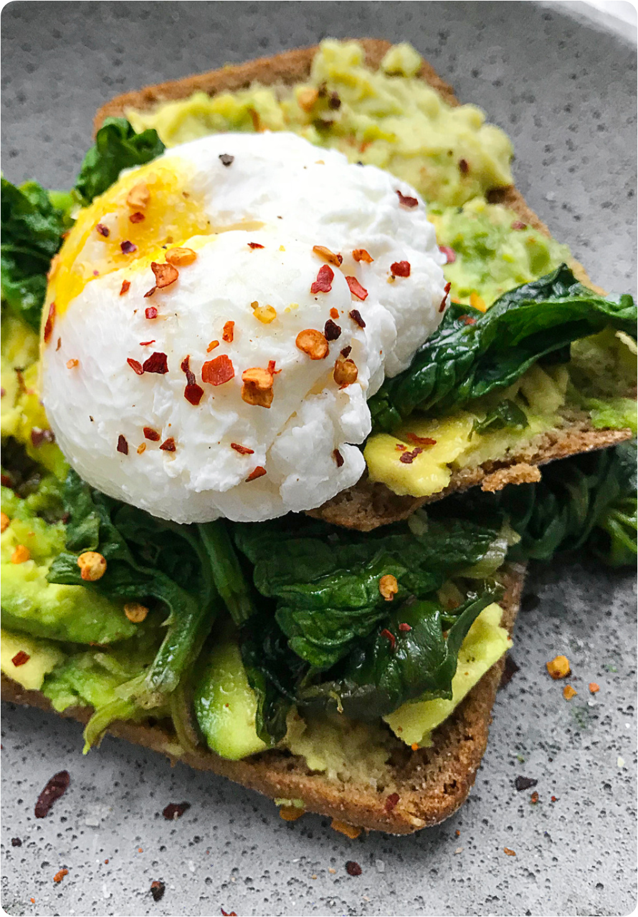
Our Fullstack Web App seamlessly integrates TypeScript and Angular on the frontend with Java and Spring Framework on the backend, ensuring an efficient user experience. Our database, using MongoDB and MySQL, caters to diverse application needs. Robust security measures, including JWT authentication, form validation, and OTP via email, underscore our commitment to user data protection.
29
Foodhut

Slide 30
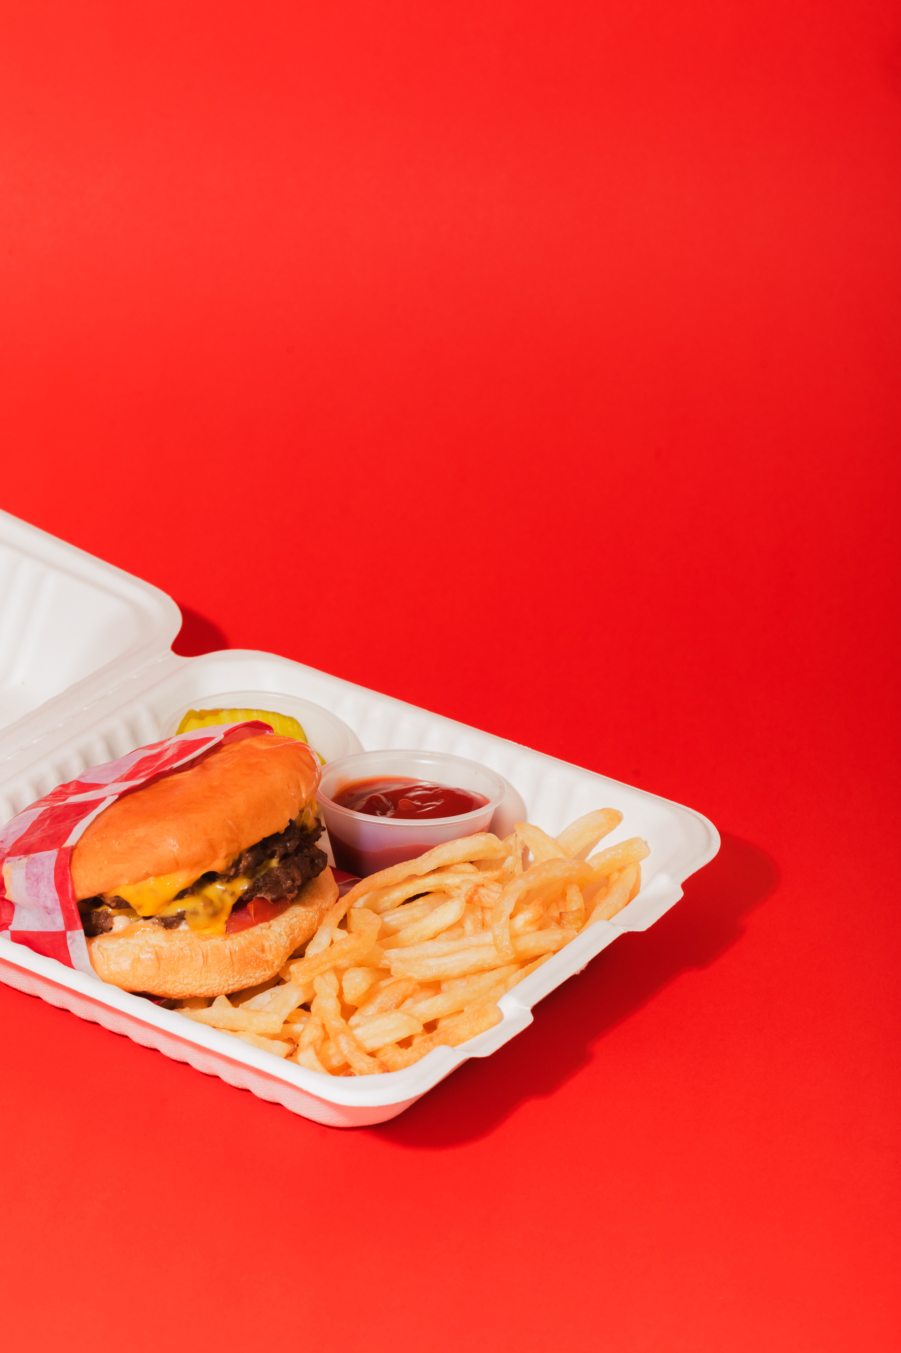

Thanks!
30
10.
Do you have any questions?
Foodhut

